Slide 1
Teacher Registration
What you need to know

Slide 2
Who is the TRBWA?
The Teacher Registration Board of Western Australia (TRBWA) replaced the Western Australian College of Teaching (WACOT) on the 7th December 2012
Notes:
No teacher cards any more as of about 31st March 2013.

Slide 3
Who are the TRBWA?
The TRBWA's Board members are appointed by the Minister for Education. The TRBWA's primary functions are:
to register teachers in Western Australia who meet all legal requirements,
to administer the disciplinary and impairment review processes, and
to accredit initial teacher education programmes which comply with accreditation standards.
Source: http://www.trb.wa.gov.au/about-us/about-the-trbwa/overview-of-trbwa

Slide 4
In performing its functions the Board is required to:
maintain an up-to-date register of teachers
develop and publish professional standards for teachers
develop and publish accreditation standards
make the best interests of children its paramount consideration in all decision-making.
Source: http://www.trb.wa.gov.au/about-us/about-the-trbwa/overview-of-trbwa

Slide 5
Renewal of Registration
YOUR REQUIREMENTS IN BRIEF
To maintain and renew your registration with the TRBWA you must pay your fees AND demonstrate ongoing maintenance of Professional Teaching Standards, at the proficient level or above, over FIVE YEARS via:
Activity Log - download the activity log here:
Teaching practice and conduct (behaving ethically & professionally etc..)
Fulfil mandatory teaching hours and professional development (100 hours of PD and 100 days of teaching as of 7th Dec 2017) but currently, as this is phased in, it may be 20 hours, 40 hours, 60 hours or 80 hours.

Slide 6
Mandatory Requirements
Renewal before 7 Dec 2013 = No set hours of Professional Learning
Renewal between… (Note: 5 year registration period)
7 Dec 2013 – 7 Dec 2014 20 Hours
7 Dec 2014 – 7 Dec 2015 40 hours
7 Dec 2015 – 7 Dec 2016 60 hours
7 Dec 2016 – 7 Dec 2017 80 hours

Slide 7
Teaching Days Requirements
The TRB uses the term ‘Professional Engagement’ to refer to days completed in an educational venue in Western Australia.
i.e. If you are renewing your registration in 2018, you MUST have completed AT LEAST 100 TEACHING DAYS AND 100 HOURS OF PROFESSIONAL LEARNING over the five years of registration. NB: One year full time teaching in WA is the equivalent of 180 teaching days.
Notes:
i.e. Professional Engagement is not referring to the AITSL Standards. Here it refers to the number of teaching days.

Slide 8
The TRB’s renewal of Registration Policy states,
“From 7 Dec 2017, the requirement during the current (expiring) registration period is for at least 100 DAYS of teaching and At least 100 HOURS of professional learning activities; pro-rated for shorter registration periods at the rate of 20 days’ teaching per year and 20 hours’ professional learning activities per year of registration”
Notes:
Link to TRBWA Policy in full
http://trb.wa.gov.au/files/2913/7644/3759/Renewal_of_Registration_Policy_.pdf

Slide 9
What do I need to do?
You need to know when your registration expires as you only receive ONE reminder
Your renewal MUST be lodged 28 days before the expiry of your current period*
You need to keep a manual activity log. This would be a summary sheet that you hand into the TRBWA to renew your registration. You do not need to submit your certificates and evidence BUT you do need to keep these for auditing purposes.
Notes:
*If that deadline is met, the registration continues, even beyond the expiry date, until renewal is granted or refused.
The activity log can be found under “Professional Learning” on the TRBWA Website: http://www.trb.wa.gov.au/further-information/professional-learning/

Slide 10
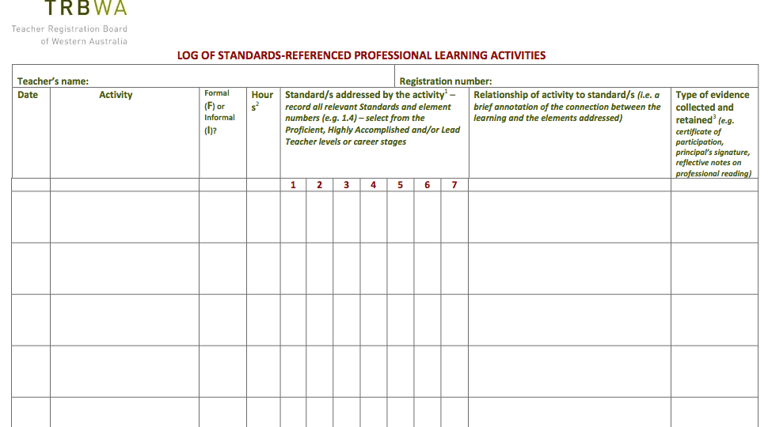

Slide 11
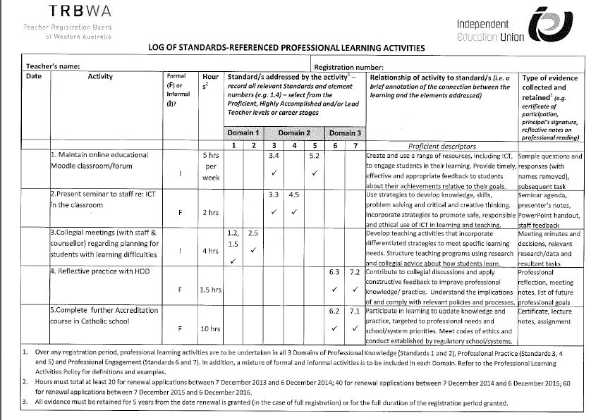
Courtesy Michelle Cofflar via IEUWA. Please visit https://ieuwa.asn.au/ for seminars on Teacher Registration today!

Slide 12
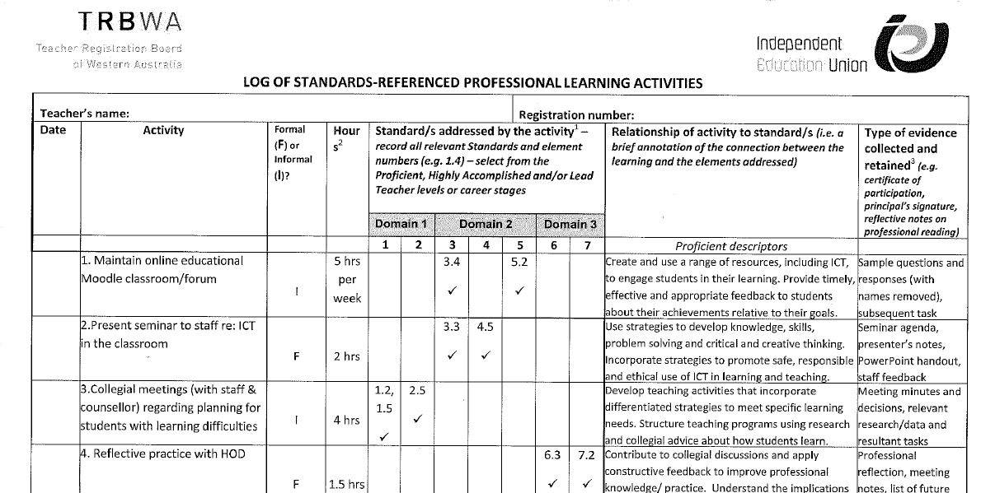
Courtesy Michelle Cofflar via IEUWA. Please visit https://ieuwa.asn.au/ for seminars on Teacher Registration today!
Notes:
REFERENCE the IEUWA here as this is THEIR WORK! IEUWA hold regular seminars to members and non-members on these topics. Look to the “events” calendar on their website for more info https://ieuwa.asn.au/events/coming-events.html

Slide 13
What counts as Professional Learning?
Must be over and above the normal expectations of a teacher’s role and responsibilities (including preparations, planning, programming, assessment and reporting). UNLESS you are changing or modifying things within the school, then this can be counted.
The activity must ‘enhance’ your teaching
The activity should “aim to improve our professional knowledge, practice and competencies as set out in the Australian Professional Standards for Teachers or the Professional Standards for Teachers in Western Australia”
Participate in formal and informal PL activities
You can find out more about what constitutes ‘Professional Learning’ here.
Notes:
Find out more about what constitutes professional learning here: http://trb.wa.gov.au/files/9613/6860/3049/TRB_Professional_Learning_Activities_Policy.pdf
You must address all 3 Domains and all 7 Standards over a five year registration period.
You must maintain records that justify how each domain is being addressed
One PL can only be placed in ONE domain & standard e.g. you can not put the same PL activity in two or three different domains.
Formal = signatures, certificates etc.. Informal = conference notes, copies of Prof Readings etc…

Slide 14
Acceptable PL
Some PL activities you already do…
Presenting or running PD sessions / workshops
Participation in whole staff PD
Participation and involvement in committees, policy development etc…
Conducting or being a part of school based action research
Upgrading qualifications
Modifying / reviewing school policies, statements etc….
Curriculum development with your staff, modifying curriculum materials, creating school based documents etc….
Attendance at conferences
Professional readings
Notes:
You can’t use your Masters degree for example, to show 20 hours of PD. It can only be listed once, in One Domain and only account for some of your PL activity hours.
You should show a variety of formal & informal activities across 7 standards but does not need to be balanced. HOWEVER Teacher context may be a factor e.g. you cant meet the Aboriginal and Torres Strait outcomes as you have none of these students in your school.

Slide 15
Where to start?
Know when your registration period expires!
Start collecting a record (& evidence) of your professional learning activities NOW!
Create a Teacher Registration file & place your ‘Activity Log’ at the front as an index page
Start filling out your log NOW!
Save your evidence in the file also (e.g. certificates, notes, attendance registers, etc…)
Notes:
You do not need to submit your evidence for TRBWA renewal but you WILL need to keep it for auditing purposes.

Slide 16
TRBWA Website
Notes:
Log onto the TRBWA website by typing www.trb.wa.gov.au/ into your browser. Select the ‘log in’ button from the top right hand side.

Slide 17
Notes:
Enter your number and password. Do not worry if you do not know your number and password as they are easily retrievable by clicking on the green text listed above and below the log in /password boxes. You can and SHOULD update your contact and employment details. There are large fines for not updating your details.

Slide 18
REMEMBER… updating your Professional Learning activities here DOES NOT COUNT AS A SUBMISSION FOR RENEWAL. It is just a method for you to keep track of your professional learning FOR YOUR OWN KNOWLEDGE
Notes:
Click on the 'Professional Learning' tab as pictured.

Slide 19
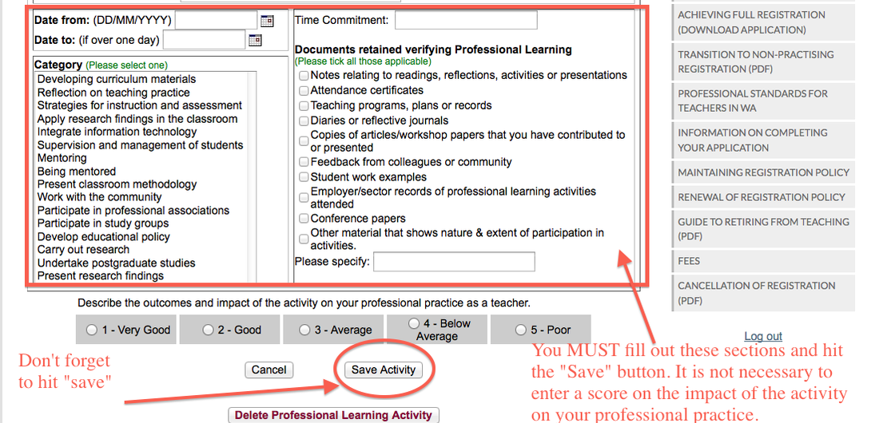
REMEMBER: This does not count as submission to the TRBWA and is to be used as a method of maintain records for your OWN USE!
Notes:
Fill out all the necessary details listed in the form box. Please note you MUST hit the save button in order for the information to be saved on the system database. It is not necessary for you to enter in a score as listed at the bottom of the page. Remember to enter in the “time commitment” as well (e.g. 4 hours)

Slide 20
National Standards WA
Professional Standards for Teachers in Western Australia are primarily the same as the National Professional Standards for Teachers (AITSL). The only difference is that the WA Teacher Standards also accommodates those Early Childhood teachers working in Child Care settings.
You may refer to either standards for renewal
Notes:
After 7th June 2013 ECE teachers in Child Care settings are required to be registered with TRBWA also.

Slide 21
Professional Standards addressed in this presentation
PROFESSIONAL PRACTICE
6.1 - identify and plan professional learning needs
6.2 – Engage in professional learning and improve practice
6.3 – engage with colleagues and improve practice
PROFESSIONAL ENGAGEMENT
7.4 – Engage with professional teaching networks and broader communities

